Slide 1
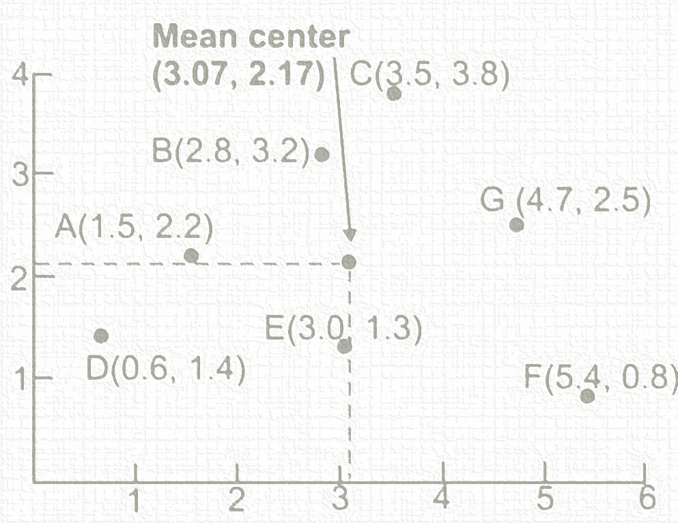
Describing spatial data
Geog4300/6300
Jerry Shannon

Slide 2
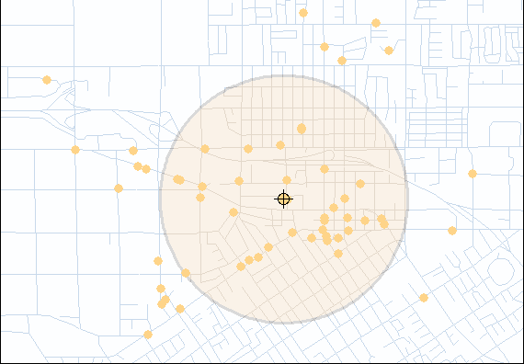
How is describing spatial data different?
Frequency distributions describe the attribute characteristics (the what or how much) of a data set
Spatial distributions describe the locational characteristics (the where) of a data set

Slide 3
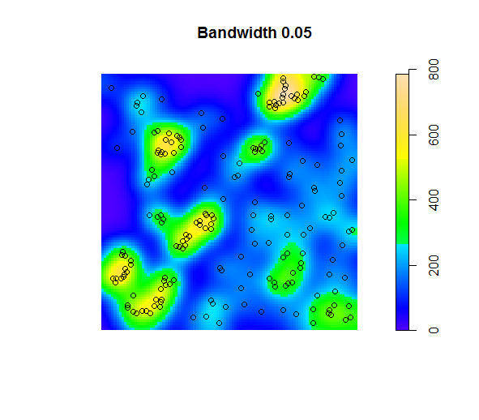
Point pattern analysis:
Methods to analyze the distribution of points and values over a surface
Notes:
There’s lots of different kinds of spatial data. What are the ways we can talk about how differences within these types of data?
Which is vector or raster data?

Slide 4
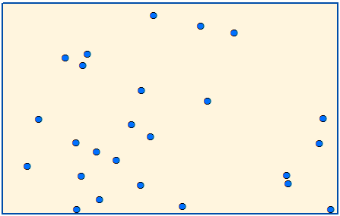
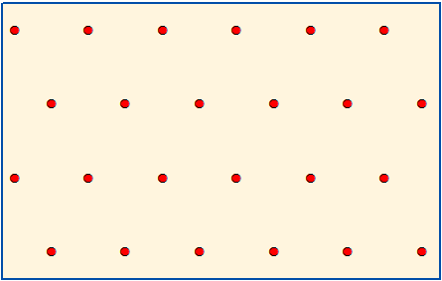
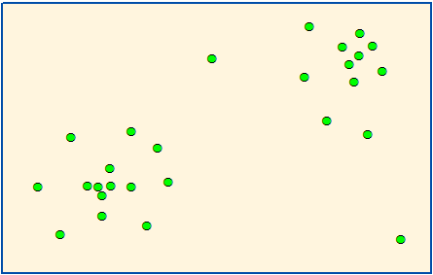
Nearest neighbor index (NNI)
How does the average distance to the nearest neighbor compare to the distance we would expect with a random distribution?
R
Random
Dispersed
Clustered

Slide 5
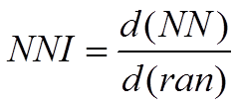
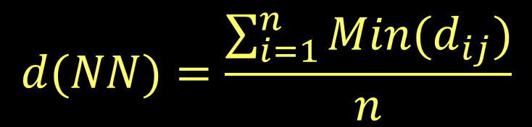
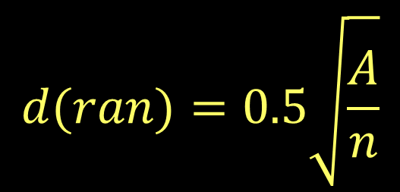
Nearest Neighbor Index (NNI)
Average NN distance
Average NN distance for random points
Sum of distances to NN/# of points
Total study area divided by # of points

Slide 6
Nearest neighbor index (NNI)
What would an NNI of 1 mean?
>1?
<1?
There’s also a significance test for NNI.
We won’t talk about it here.

Slide 7
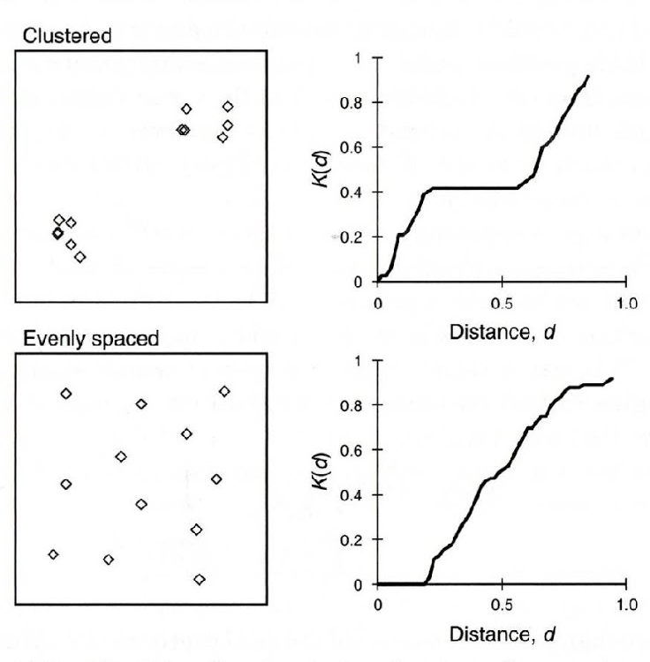
Ripley’s K show evidence of clusters at particular scales
Are there clusters?
At what scale do these clusters emerge?
clustered
dispersed

Slide 8
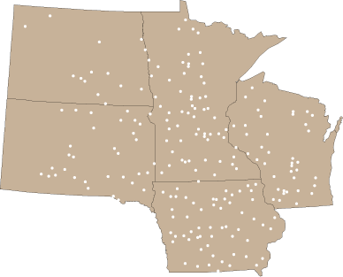
Location Quotient (LQ)
Analyzes distribution of categorical/ordinal data
LQ compares the distribution of an subset activity relative to a standard (all activities)
It compares actual data to the rates expected if counts were evenly distributed
Given all tornadoes in the five-state area, which state has a disproportionate number of severe tornadoes?
Notes:
There’s lots of different kinds of spatial data. What are the ways we can talk about how differences within these types of data?
Which is vector or raster data?

Slide 9

Location Quotient (areal data)
# of tornadoes: 207
# of severe tornadoes: 41
Rate of severe tornadoes:
41/207=19.8%

Slide 10
Location Quotient (areal data)
In Minnesota
# of tornadoes: 64
# of severe tornadoes: 10
Rate of severe tornadoes:
10/64=15.6%

Slide 11
Location Quotient (areal data)
LQ_{subregion}= rate_{subregion}/rate_{region}
LQ_{MN}= 15.6/19.8=0.788

Slide 12
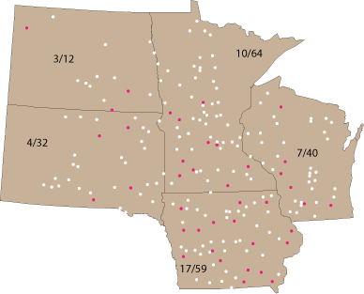
Location Quotient (areal data)
LQ_{subregion}= rate_{subregion}/rate_{region}
LQ_{MN}= 15.6/19.8=0.788

Slide 13
Location Quotient (areal data)
LQ_{subregion} = rate_{subregion}/rate_{region}
Find the LQ for Iowa and South Dakota. (Regional rate = 19.8%)

Slide 14
Location Quotient (areal data)
 | # severe tornadoes | # tornadoes | rates
IA | 17 | 59 | 0.288
MN | 10 | 64 | 0.156
ND | 3 | 12 | 0.250
SD | 4 | 32 | 0.125
WI | 7 | 40 | 0.175
all | 41 | 207 | 0.198
LQs
1.455
0.788
1.260
0.631
0.884
if LQ > 1,
there is a disproportionately high rate in that subregion
If LQ < 1,
there is a disproportionately low rate in that subregion
If LQ = 1
the subregion’s rate is equal to that of the region

Slide 15
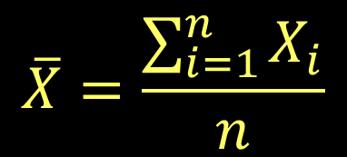
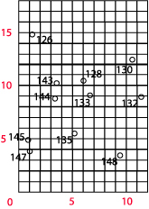
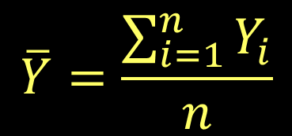
Mean Center
Tells you about the middle of the distribution.
Focus on distribution, not values
Mean center: (5.18, 8.36)

Slide 16
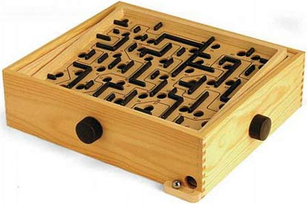
Mean Center
The mean center is the balance point, or center of gravity
What would happen if each point had a different mass?

Slide 17
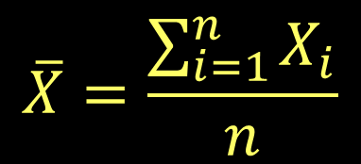
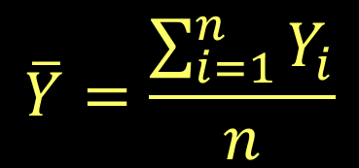
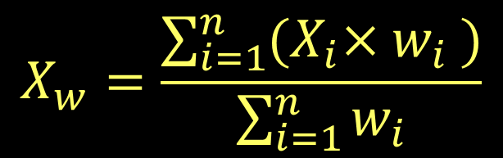

Weighted Mean Center
(unweighted) mean center
multiply (weight) each x and y coordinate by the value of the observation before you sum them.
Here, w = the weighting variable.

Slide 18

Weighted Mean Center
Mean center: (5.18, 8.36)
0.9*145 + 1.0*147 + 1.1*126 + … 11.3*132
X_{w} =
145 + 147 + 126 + … 132
8063.6
= 4.99
X_{w} =
1511
WMC is pulled down and to the left in this case: why?
Y_{w} =
7.89
weighed mean center: (4.99, 7.89)

Slide 19
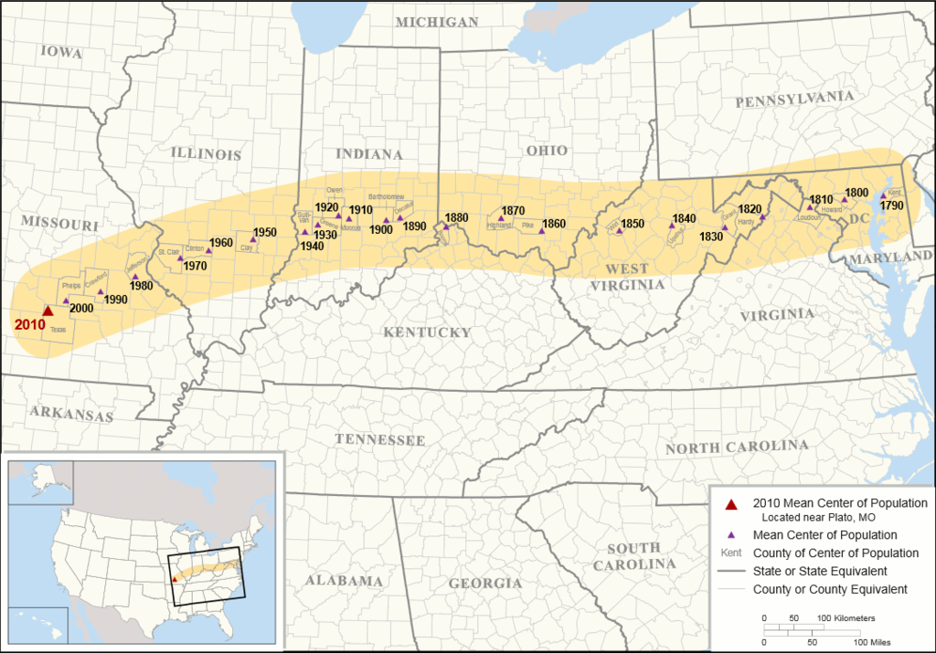

Slide 20
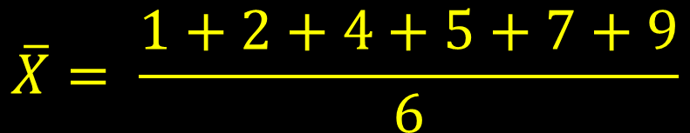
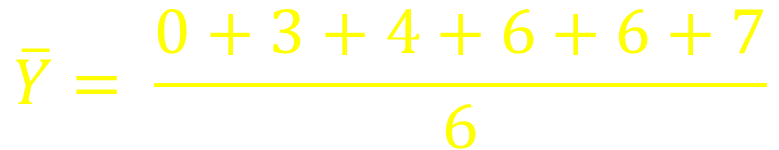
Centroid
Polygon Centroid
Often calculated as the mean center of all vertices of the polygon
(4,7)
(2,6)
(7,6)
(1,4)
(9,3)
$$\overline{X}= \frac{1+2+4+5+7+9}{6}$$
$$\overline{Y}= \frac{0+3+4+6+6+7}{6}$$
(5,0)

Slide 21


Centroid
Polygon Centroid
Often calculated as the mean center of all vertices of the polygon
(4,7)
(2,6)
(7,6)
(1,4)
(9,3)
$$\overline{X}=4.67$$
$$\overline{Y}=4.33$$
(5,0)

Slide 22
Try it out
Download the tornado points data (in data folder on GitHub)
Use Excel (or R) to calculate the mean center of all counties, using CLONG and CLAT
Calculate weighted mean center based on # of injuries (calculate numerator and denominator)

Slide 23
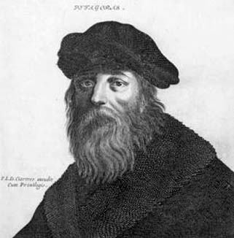
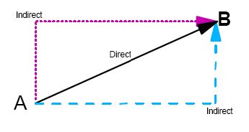
Standard distance
Remember Pythagoras?
Equivalent to standard deviation
Looks all right to me!
How would you calculate the distance (d) from point A to point B?
d² = (x_{A} – x_{B})² + (y_{A} – y_{B})²

Slide 24
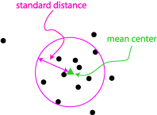
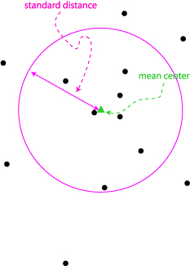
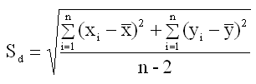
Standard distance: the average distance
The greater the s.d., the greater the dispersion of the points

Slide 25
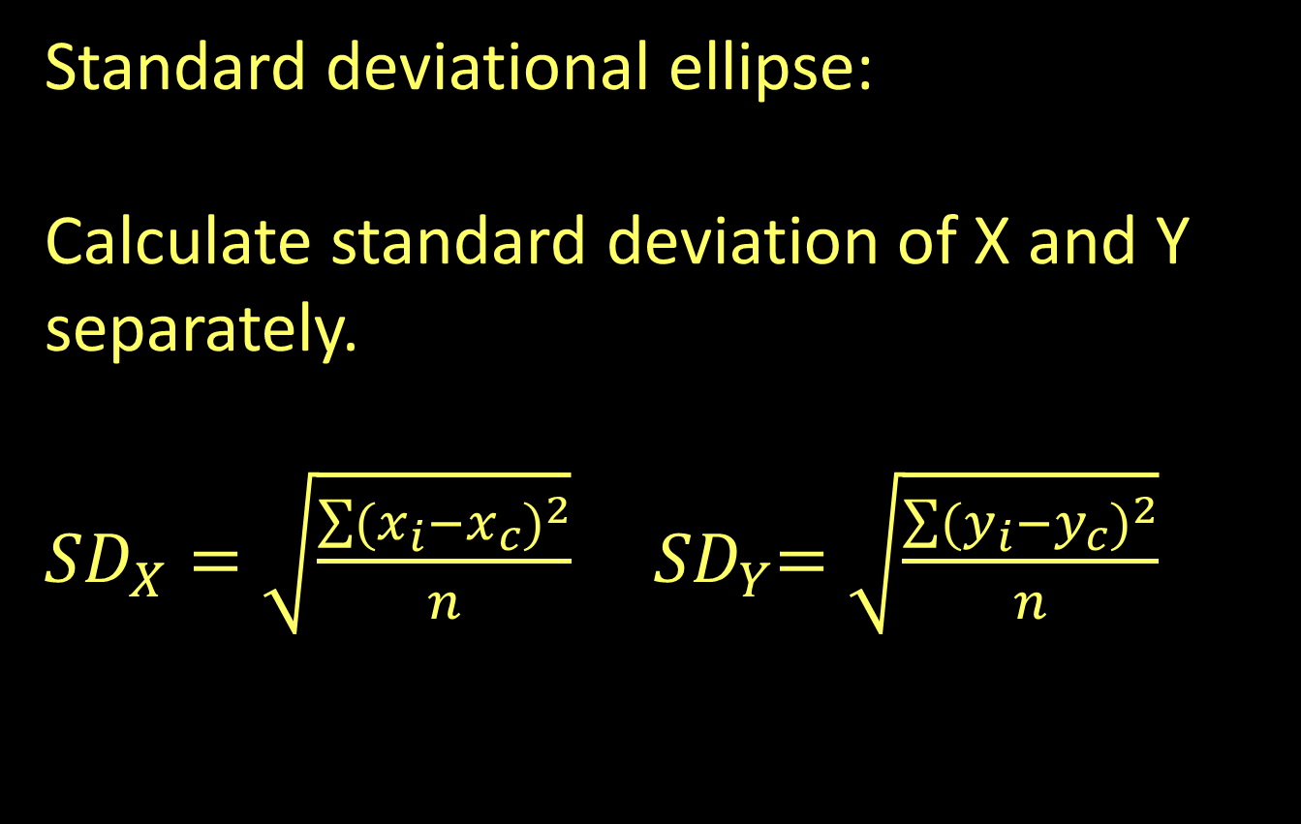

Slide 26
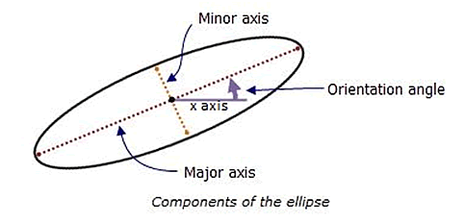
Standard deviational ellipse
Use each standard deviation to create a right angle, then draw an ellipse around it.

Slide 27
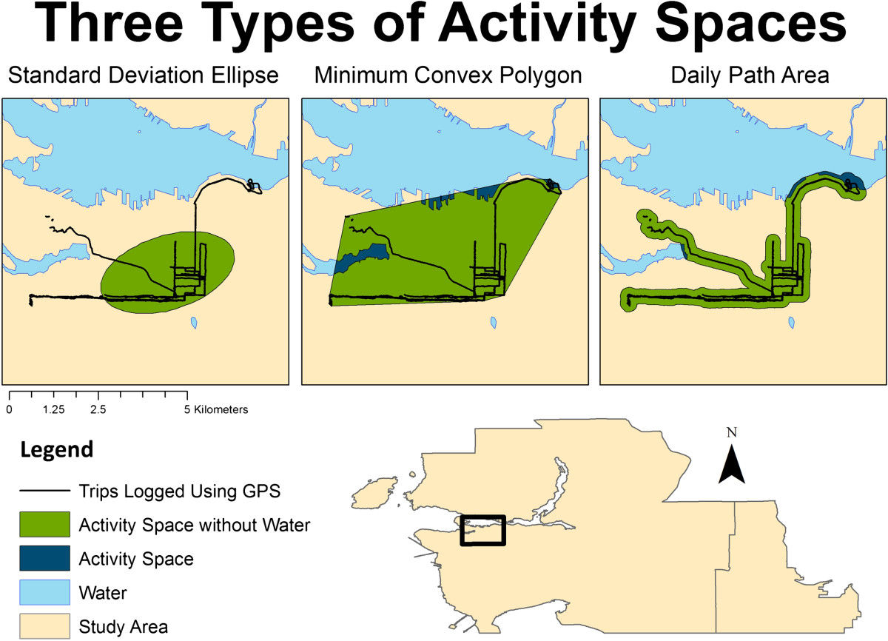
Standard deviational ellipse
Used to calculate “activity spaces” and other spatial distributions
Hirsch, Winters, Clarke, and McKay (2014). International Journal of Health Geographics

Slide 28
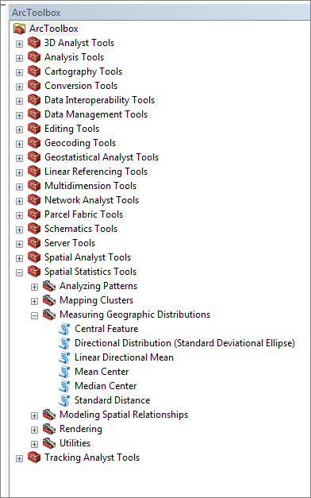
ArcGIS has a function to calculate standard deviation ellipses.

Slide 29
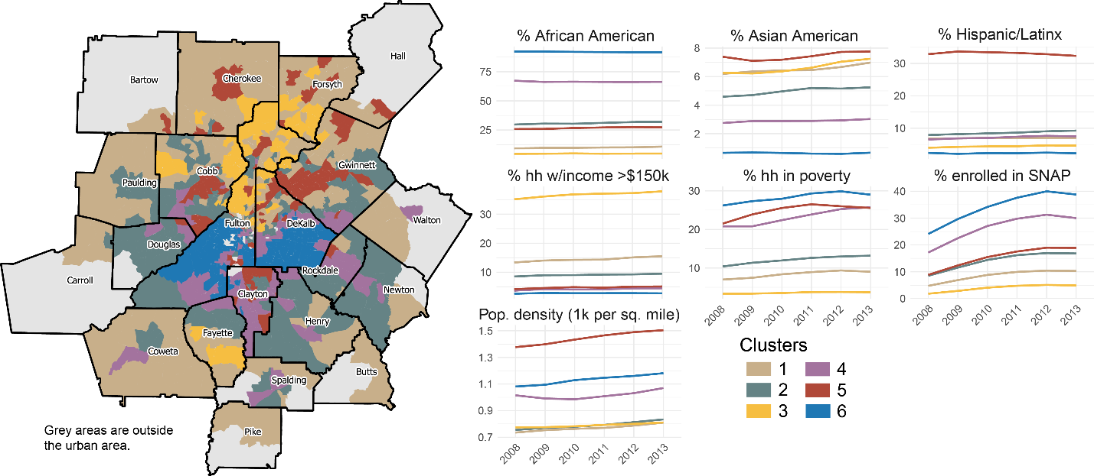
Clustering
K-means and HCA can identify clusters based on multiple attributes

Slide 30
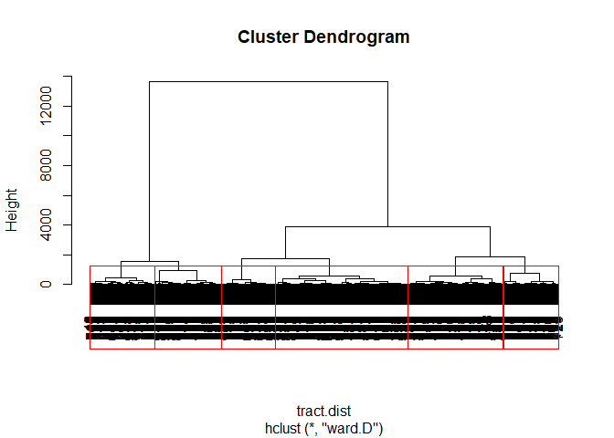
Clustering
K-means and HCA can identify clusters based on multiple attributes

